Slide 1
Movie Recommendation System
E E 596 A Su 22 - Recommender System Final Project
Bing Syuan Wang, Michelle Liu

Slide 2
Notes:
These are the platforms we often use to watch movies

Slide 3
Trending Movie
Notes:
When we talk about the trending movie

Slide 4
Views
Release Date
Popularity
Trending Movie
Genre
Sponsor
Notes:
The recommendation system would base on several factors, including Release Date, Views, Popularity, Genre, and the Sponsor

Slide 5
Personal Recommendation System
Notes:
So we want to do a recommendation system only based on Personal habit

Slide 6
The Movie Database
(TMDb, https://www.themoviedb.org/)
Title
Genre
Actor
Director
Overview
Notes:
We use the TMDB as our database,
And we use the field of title genre actor director and overview

Slide 7
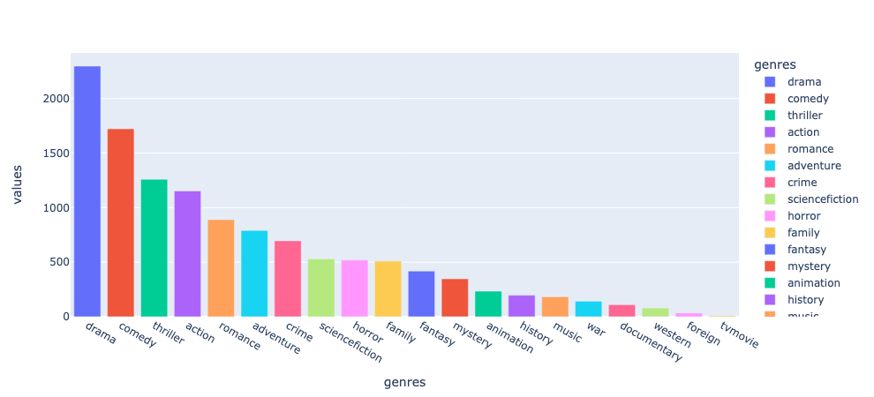
Movie Genres
Notes:
This is the movie genres of the database; you can see that the drama movie account for the most

Slide 8
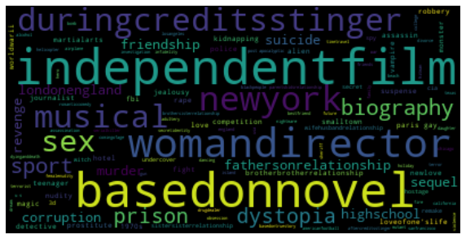
Movie Keywords
Notes:
And these are the movie keywords

Slide 9
1. Recommend by Rating
Notes:
So first, we do the Recommend by Rating

Slide 10

$$IMDb Rating=\frac{v}{v+m}×R+\frac{m}{v+m}×C$$
Reference:
https://www.quora.com/How-does-IMDbs-rating-system-work
R = average for the movie (mean)
v = number of votes for the movie
m = minimum votes required to be listed in the Top 250
C = the mean vote across the whole report
Notes:
We use IMDB’s formula to calculate the data result of TMDB

Slide 11
Top 10 by IMDb rating algorithm
index | title | release_date | score_IMDB | vote_average | IMDB_rating
1881 | The Shawshank Redemption | 1994/9/23 | 8.05 | 8.5 | 1
662 | Fight Club | 1999/10/15 | 7.93 | 8.3 | 12
65 | The Dark Knight | 2008/7/16 | 7.92 | 8.2 | 3
3232 | Pulp Fiction | 1994/10/8 | 7.9 | 8.3 | 8
96 | Inception | 2010/7/14 | 7.86 | 8.1 | 13
3337 | The Godfather | 1972/3/14 | 7.85 | 8.4 | 2
95 | Interstellar | 2014/11/5 | 7.8 | 8.1 | 27
809 | Forrest Gump | 1994/7/6 | 7.8 | 8.2 | 11
329 | The Lord of the Rings: The Return of the King | 2003/12/1 | 7.72 | 8.1 | 7
1990 | The Empire Strikes Back | 1980/5/17 | 7.69 | 8.2 | 15
Notes:
This is the result of the top ten TMDB database which use the IMDB’s formula, and then you can see the column on the right side, which is the original ranking of IMDB
This shows that two database has repetitive ranking when using the same formula, which mean the IMDB’s formula is credible

Slide 12
2. Recommend by Overview

Slide 13
Movie
Overview
(4803x1)
TF-IDF
(4803x20987)
Cosine
Similarity
(4803x4803)
Get
Recommend
Cosine Similarity Score by Movie Index
Cosine Similarity Score by Movie Index
Notes:
We use the overview from TMDB database
And use TFI-IDF to get a vector matrix of 4803*20987
And then we do cosine similarity to compare the score of cosine
After we get the score, the highest one would be our recommendation

Slide 14
Top 10 by Overview
The Lord of the Rings: The Fellowship of the Ring
index | title | cosine_score | note
262 | The Lord of the Rings: The Fellowship of the Ring | 1
98 | The Hobbit: An Unexpected Journey | 0.195158 | Series
22 | The Hobbit: The Desolation of Smaug | 0.180959 | Series
329 | The Lord of the Rings: The Return of the King | 0.166745 | Series
330 | The Lord of the Rings: The Two Towers | 0.147305 | Series
1933 | Underclassman | 0.124586 | "young", "ring" in overview
4185 | Sublime | 0.119095 | "ring" in overview
2344 | Raging Bull | 0.117544 | "ring" in overview
1616 | What's the Worst That Could Happen? | 0.117095 | "ring" in overview
3714 | Exiled | 0.112993 | "ring" in overview
1438 | Krull | 0.094786 | "protect" in overview
Notes:
This is the recommend result when we use The Lord of the Rings: The Fellowship of the Ring to be the as the original movie
Top five is the serios of the lord of the rings
And the rest is recommend based on some keyworks

Slide 15
3. Recommend by
Title, Cast, Director,
Keywords, Genres, Overview

Slide 16
Title,
Cast,
Director,
Keywords,
Genres,
Overview
(4363x6)
CountVectorizer(4363x34242)
Cosine
Similarity
(4363x4363)
Get
Recommend
To one array list
[title 1, title 2, …, cast 1, cast 2, …, director 1, director 2, …,
keyword 1, keyword 2, …, genres 1, genres 2, …, overview 1, overview 2, …]
Notes:
We turn Title, Cast, Director, Keywords, Genres, Overview to an array list
And then do the CountVectorizer, Cosine Similarity and get recommend

Slide 17
Top 10 by Title, Cast, Director, Keywords, Genres, Overview
The Lord of the Rings: The Fellowship of the Ring
index | title | cosine_score | note
259 | The Lord of the Rings: The Fellowship of the Ring | 1 | titles x 4, cast x 5, director x 1, keywords x 5, genres x 3, overview x 33
326 | The Lord of the Rings: The Two Towers | 0.42956 | titles x 2, cast x 3, director x 1, keywords x 4, genres x 3, overview x 4
325 | The Lord of the Rings: The Return of the King | 0.396438 | titles x 2, cast x 3, director x 1, keywords x 3, genres x 3, overview x 3
95 | The Hobbit: An Unexpected Journey | 0.395130 | cast x 2, director x 1, keywords x 4, genres x 3, overview x 4
22 | The Hobbit: The Desolation of Smaug | 0.339932 | cast x 1, director x 1, keywords x 4, genres x 2, overview x 2
19 | The Hobbit: The Battle of the Five Armies | 0.339343 | cast x 1, director x 1, keywords x 4, genres x 3, overview x 3
1580 | What's the Worst That Could Happen? | 0.195311 | genres x 1, overview x 2
1407 | Krull | 0.147844 | genres x 3, overview x 2
2264 | Raging Bull | 0.133352 | overview x 3
1885 | Underclassman | 0.130677 | genres x 1, overview x 2
61 | Jupiter Ascending | 0.126295 | cast x 1, genres x 3, overview x 1
Notes:
This is the result, On the right you can clearly see why it is recommended

Slide 18
4. Logistic Regression

Slide 19
Title,
Cast,
Director,
Keywords,
Genres,
Overview
(4363x6)
CountVectorizer(4363x34242)
Cosine
Similarity
(4363x4363)
Second Highest Score
X
(4363x34242)
Y
(4363x1)
Logistic Regression
Notes:
We take Countcbectorizer asＸ
Since This is a data without a label, so we create Y by ourselves. We take the cosine similar of second highest movie as Y

Slide 20
Title,
Cast,
Director,
Keywords,
Genres,
Overview
(4363x6)
CountVectorizer(4363x34242)
Cosine
Similarity
(4363x4363)
Second Highest Score
X
(4363x34242)
Y
(4363x1)
Logistic Regression
Accuracy: 0.13
Notes:
The accuracy is only 0.13
Well, it’s Not high. But, it works!

Slide 21
getRecBySklearnModel([
'The Lord of the Rings: The Fellowship of the Ring’,
'The Hobbit: An Unexpected Journey’,
], model_lr)
Predict index: 326
Predict movie title: The Lord of the Rings: The Two Towers
Diff with input movie "The Lord of the Rings: The Fellowship of the Ring":
titles x 2 cast x 3 director x 1 keywords x 4 genres x 3 overview x 4
Diff with input movie "The Hobbit: An Unexpected Journey":
cast x 1 director x 1 keywords x 3 genres x 3
Notes:
This is the result when we use two the lord of ring movie,
The recommend would be the lord of ring movie as well

Slide 22
getRecBySklearnModel(
df_new.title.sample(n=3, random_state=10).tolist(),
model_lr)
Genres: drama
Predict index: 4035
Predict movie title: Love Me Tender
Diff with input movie "The Passion of the Christ":
genres x 1 overview x 1
Diff with input movie "A Madea Christmas":
genres x 1
Diff with input movie "Coal Miner's Daughter":
genres x 2
Notes:
And we use three random movies, is recommd a movie based on Genres, in here is drama

Slide 23
getRecBySklearnModel([
'The Matrix’,
'The Matrix Reloaded’,
'Speed’,
'Point Break’
], model=model_lr)
Predict index: 120
Predict movie title: The Matrix Revolutions
Diff with input movie "The Matrix":
titles x 1 cast x 4 director x 2 keywords x 4 genres x 2
Diff with input movie "The Matrix Reloaded":
titles x 1 cast x 4 director x 2 keywords x 3 genres x 4 overview x 6
Diff with input movie "Speed":
cast x 1 genres x 2 overview x 1
Diff with input movie "Point Break":
genres x 2 overview x 1
Notes:
We put The Matrix, The Matrix Reloaded, Speed, Point Break
It recommend The Matrix Revolutions
And the reason is

Slide 24
getRecBySklearnModel([
'The Matrix’,
'The Matrix Reloaded’,
'Speed’,
'Point Break’
], model=model_lr)
Predict index: 120
Predict movie title: The Matrix Revolutions
Diff with input movie "The Matrix":
titles x 1 cast x 4 director x 2 keywords x 4 genres x 2
Diff with input movie "The Matrix Reloaded":
titles x 1 cast x 4 director x 2 keywords x 3 genres x 4 overview x 6
Diff with input movie "Speed":
cast x 1 genres x 2 overview x 1
Diff with input movie "Point Break":
genres x 2 overview x 1
Notes:
They are all performed by ‘ki a nu rivs’

Slide 25
5. MLP (Multi-layer perception)
Notes:
MLP (Multi-layer perception)
Use neural network do deep learning

Slide 26
Input
Layer
34242
HiddenLayer 1
512
(relu)
Hidden
Layer 2
64
(relu)
Hidden
Layer 3
64
(relu)
Hidden
Layer 4
512
(relu)
Output
Layer
4363
(softmax)
Total params: 19,840,907
Notes:
CountVectorizer has 34242 data
There are four hidden layer-> they are all Activation function which is relu
The final output function is softmax
In total output 4363 class comes from our 4363 movies
And the total parameters is 19,840,907

Slide 27
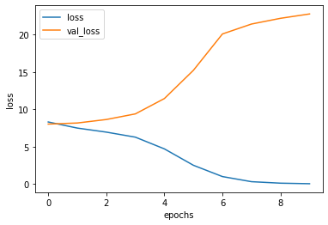
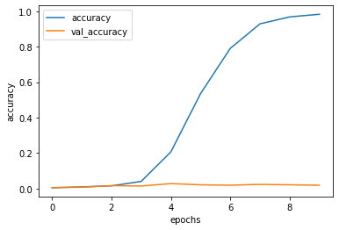
Loss History
Accuracy History
Notes:
The result of the Loss accuracy
Is, Training is getting better
But validation seems not haha

Slide 28
getRecByMLP([
'The Lord of the Rings: The Fellowship of the Ring’,
'The Hobbit: An Unexpected Journey’,
], model_mlp)
Predict index: 22
Predict movie title: The Hobbit: The Desolation of Smaug
Diff with input movie "The Lord of the Rings: The Fellowship of the Ring":
cast x 1 director x 1 keywords x 4 genres x 2 overview x 2
Diff with input movie "The Hobbit: An Unexpected Journey":
titles x 1 cast x 3 director x 1 keywords x 3 genres x 2 overview x 5
Notes:
When we put two the lord of ring movie,
The result of logic regression is the lord of ring
But the result of MLP is hobbit
Well they come from the same serious

Slide 29
getRecByMLP(
df_new.title.sample(n=3, random_state=10).tolist(),
model_mlp)
Genres: drama
Predict index: 3851
Predict movie title: Sherrybaby
Diff with input movie "The Passion of the Christ":
genres x 1 overview x 1
Diff with input movie "A Madea Christmas":
genres x 1 overview x 1
Diff with input movie "Coal Miner's Daughter":
genres x 1
Overview: especially
Overview: daughter
Notes:
When we use three random movies
part not only consider genres
But also use the keywords of overview

Slide 30
getRecByMLP([
'The Matrix’,
'The Matrix Reloaded’,
'Speed’,
'Point Break’
], model=model_mlp)
Predict index: 120
Predict movie title: The Matrix Revolutions
Diff with input movie "The Matrix":
titles x 1 cast x 4 director x 2 keywords x 4 genres x 2
Diff with input movie "The Matrix Reloaded":
titles x 1 cast x 4 director x 2 keywords x 3 genres x 4 overview x 6
Diff with input movie "Speed":
cast x 1 genres x 2 overview x 1
Diff with input movie "Point Break":
genres x 2 overview x 1
Same as Logistic Regression
Notes:
Same as Logistic Regression, all movies are form ki a nu rivs’

Slide 31
Feature work

Slide 32
Feature work
History weight
Movie 1
Movie 2
[feature 1, feature 2, …] + [feature 1, feature 2, …] + …
X 3
X 2
Notes:
We want to add History wright，which means the closer time, the higher weight
#因為我們可以組合多個電影的feature，並且都是算每個關鍵字出現的次數，所以可以透過權重來增減

Slide 33
Feature work
History weight
Feature weight
Keyword X 2
Overview X 3
Title X 4
Notes:
We want to add weight based on feature to effect the final score

Slide 34
Feature work
History weight
Feature weight
Multiple result for ML models
[ A , B , C , …]
[0.59, 0.43, 0.87, …]
MLP models return probabilities
Notes:
Because the results output by MLP are all probabilities,
And traditionally, only we will only get the the highest scores of the classification results
Therefore, we would want to add multiple recommendations in the future

Slide 35
Feature work
History weight
Feature weight
Multiple result for ML models
New accuracy metrics
Notes:
The accuracy of logistic regression and MLP is Because we use cosine similarity as y, the result will not the same as Y
So we would like to find a better solution to solve this problem

Slide 36
Q&A

